Slide 1

Attention in Sequence-to-Sequence Models
Week 9 Mini Survey Luis Alberto Portilla López

Slide 2
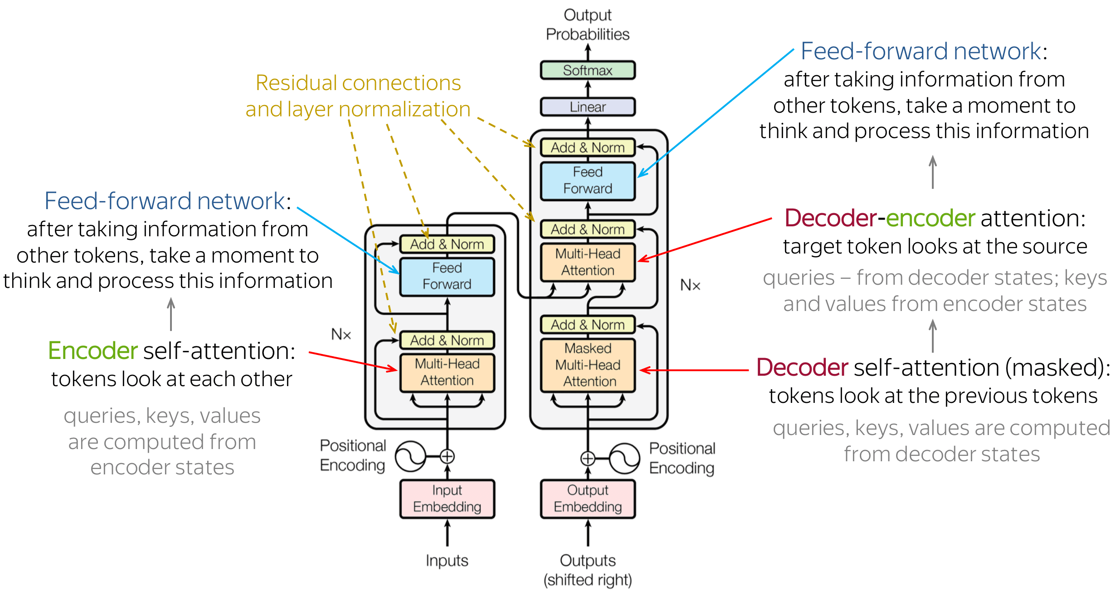
Attention mechanism
Virtually identical to original encoder-decoder architecture. With the addition of the attention mechanism, the context vector is eliminated,
although we also eliminate the natural hierarchy with stacked encoder-decoder models

Slide 3
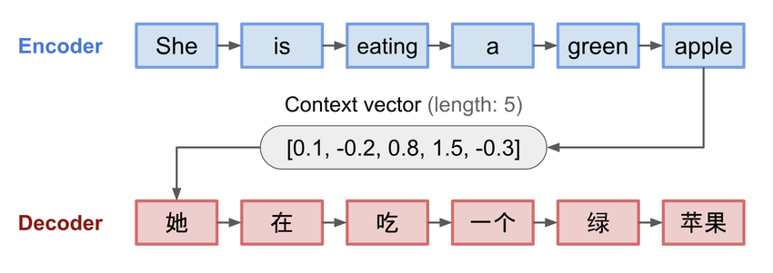
What problem it solves
Although better than normal RNN’s, non-attention Encoder-Decoder mechanisms still struggle with longer sequences, due to the gradual loss of information from one layer to another in the encoder, and then having to compress it all in the fixed-size context vector, this is improved with the attention mechanism

Slide 4
Challenges
Computational complexity, especially for larger sequences of data
Lack of explicit hierarchy
Struggles with noisy datasets, prone to overfitting on smaller models

Slide 5

Search Methodology & Criteria
Keyword Search
Boolean Search
Citation Chaining and Forward Citation
CRITERIA:
• Initial review of abstracts to assess relevance based on the title, publication venue, and year.
• Direct and indirect relevance to the paper being cross-referenced through the abstract.
• Consideration of the number of citations and field-weighted citation impact (fwci), a metric that measures the citation impact of a paper adjusted for disciplinary differences.

Slide 6

Preliminary Terms
Key terms identified during the week:
Attention
• Self-attention
• Global attention
• Local attention
Alignment

Slide 7


Document Comparison
“Attention Is All You Need”
“A Review on Speech Emotion Recognition Using Deep Learning and Attention Mechanism”
“Attention Mechanisms in Computer Vision: A Survey”
“Effective Approaches to Attention-based Neural Machine Translation”

Slide 8
Characteristic | Attention Is All You Need | A Review on Speech Emotion Recognition Using Deep Learning and Attention Mechanism | Attention Mechanisms in Computer Vision: A Survey | Effective Approaches to Attention-based Neural Machine Translation
Primary Focus | Proposing the Transformer architecture with self-attention for NLP tasks. | Analyzing attention mechanisms in speech emotion recognition (SER). | Surveying attention mechanisms applied in computer vision tasks. | Introducing global and local attention mechanisms for NMT.
Types of Attention | Self-attention (scaled dot-product attention). | Hybrid attention combining temporal and spatial attention for SER. | Spatial, channel-wise, temporal, and self-attention mechanisms. | Global and local attention mechanisms.
Model Architecture | Transformer architecture without recurrence or convolution. | Encoder-decoder models with attention mechanisms. | Hybrid CNN and attention architectures; Transformer-based models. | Encoder-decoder models with attention layers.
Datasets | WMT’14 English-to-German and English-to-French datasets. | IEMOCAP, RAVDESS, and other SER-specific datasets. | ImageNet, COCO, and other standard vision datasets. | WMT’15 English-to-Czech and IWSLT datasets.

Slide 9
Characteristic | Attention Is All You Need | A Review on Speech Emotion Recognition Using Deep Learning and Attention Mechanism | Attention Mechanisms in Computer Vision: A Survey | Effective Approaches to Attention-based Neural Machine Translation
Evaluation Metrics | BLEU scores for translation quality. | Accuracy, F1 score, and emotion-specific metrics. | Top-1 accuracy, mean Average Precision (mAP), and F1 score. | BLEU scores for translation quality.
Contributions and Novelty | Introduced the Transformer and positional encodings; eliminated the need for recurrence. | Highlighted how attention improves emotion detection by focusing on relevant parts of audio signals. | Comprehensive analysis of attention’s role in vision; proposed unified taxonomy. | Introduced local attention for faster computations while retaining relevance.
Challenges and Limitations | High computational and memory requirements; quadratic scaling with input length. | Struggles with noisy audio and variability in emotional expressions. | Increased computational complexity; overfitting in small datasets. | Local attention may miss critical global context; limited interpretability of alignment.
Performance Insights | Achieved state-of-the-art results on machine translation benchmarks. | Improved emotion detection accuracy and robustness compared to non-attention models. | Attention enhances interpretability and performance in object detection, segmentation, and classification. | Improved translation accuracy and speed compared to models without attention.

Slide 10
Characteristic | Attention Is All You Need | A Review on Speech Emotion Recognition Using Deep Learning and Attention Mechanism | Attention Mechanisms in Computer Vision: A Survey | Effective Approaches to Attention-based Neural Machine Translation
Future Directions | Scaling Transformers to larger datasets; exploring sparsity in attention mechanisms. | Exploring multimodal attention mechanisms (e.g., combining text and speech). | Integrating attention into real-time vision tasks and lightweight models. | Refining local attention for better alignment and efficiency in long sequences.

Slide 11
References
1. Vaswani, A., Shazeer, N., Parmar, N., Uszkoreit, J., Jones, L., Gomez, A. N., Kaiser, Ł., & Polosukhin, I. (2017). Attention Is All You Need. Advances in Neural Information Processing Systems, 30, 5998–6008.
2. Latif, S., Qayyum, A., Usama, M., Ullah, S., & Farooq, S. (2020). A Review on Speech Emotion Recognition Using Deep Learning and Attention Mechanism. IEEE Access, 8, 4875–4885.
3. Khan, S., Naseer, M., Hayat, M., Zamir, S. W., Khan, F. S., & Shah, M. (2021). Attention Mechanisms in Computer Vision: A Survey. IEEE Transactions on Pattern Analysis and Machine Intelligence.
4. Luong, M.-T., Pham, H., & Manning, C. D. (2015). Effective Approaches to Attention-based Neural Machine Translation. Proceedings of the 2015 Conference on Empirical Methods in Natural Language Processing (EMNLP), 1412–1421.

